Slide 1
HEA Fellowship
Practice Education Specialist Interest Group - Health and Social Care
29 March 2017
Louise Lumsden SFHEA

Slide 2
HEA Fellowship
The UKPSF and how HEA professional recognition applies to practice educators and those individuals supporting learning in practice

Slide 3
UK Professional Standards Framework (UKPSF)
Provides a set of Descriptors, developed with the sector, against which individuals and institutions can benchmark their approaches to professional development;
Offers Universities, Colleges and HE providers criteria which support the initial and continuing professional development for staff who teach and support student learning.

Slide 4
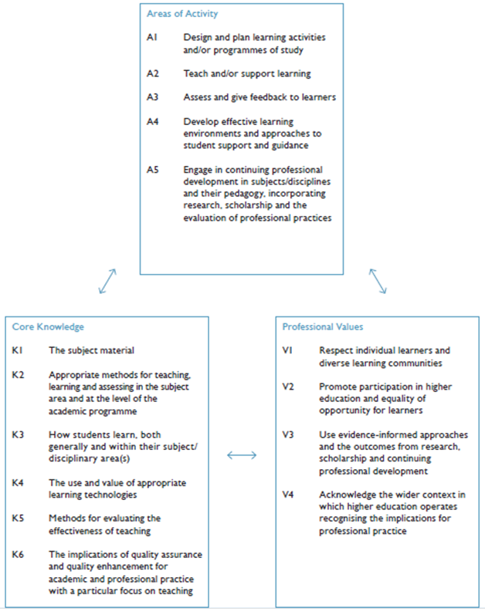
The UKPSF
The framework organises the components of teaching and supporting learning into three dimensions – the Dimensions of the Framework (page 3)
Areas of Activity - describes what a teaching and learning professional does
Core Knowledge - outlines what they need to know
Professional Values - outlines the manner in which they should carry out their activity
These dimensions are then used to construct 4 Descriptors to recognise the success of a range of teaching and learning professionals.
Descriptor 1 = Associate Fellowship (AFHEA)
Descriptor 2 = Fellowship (FHEA)
Descriptor 3 = Senior Fellowship (SFHEA)
Descriptor 4 = Principal Fellowship (PFHEA)

Slide 5
The Dimensions of the Professional Standards Framework
https://www.heacademy.ac.uk/ukpsf
Areas of Activity
Undertaken by teachers and supporters of learning within HE
Professional Values
Someone performing these activities should embrace and exemplify
Core Knowledge
Needed to carry out those activities at the appropriate level

Slide 6
Current Fellowship numbers *Numbers correct as of 30 June 2017
Category of HEA Fellowship Awarded | Number of individuals
Associate Fellow | 18,127
Fellow | 64,564
Senior Fellow | 6,654
Principal Fellow | 762
Grand Total | 90,107

Slide 7
Current Fellowship numbers for individuals who have recorded “health” in their title/role *Numbers correct as of 5th July 2017
Category of HEA Fellowship Awarded | Number of individuals
Associate Fellow | 11,51
Fellow | 9,020
Senior Fellow | 824
Principal Fellow | 123
Notes:
These are the numbers to date- but very difficult to drill down further as to true nature of roles undertaken by these individuals.
Many involved in practice learning take forward associate fellowship or fellowship. However it is always dependent on the learning and teaching activities you are undertaking in the role (practice educators are not a uniform group!- e.g. practice learning management is very different to a clinical tutor and therefor their fellowship claim and category may differ).

Slide 8
Knowledge hub
NTF outlines
Research
Case studies
Discipline specific & thematic
HEA Blogs
HEA Toolkits
#HEAchat
Our regular Twitter chat with #LTHEchat on teaching & learning issues in HE/FE join us to connect, share & get inspired. 8pm last Weds. of the month, term time.
Notes:
These are a few of the learning opportunities available to you
Blogs from across the sector
Toolkits to help with learning conversations
Knowledge hub to search for research & resources

Slide 9
If you would like further details about Fellowship, visit the HEA website and download a pack to begin an application for Fellowship

Slide 11
Future Nurse Standards and Education Framework: Consultation
https://www.nmc.org.uk/globalassets/sitedocuments/councilpapersanddocuments/council-2017/council-item-7-may-2017.pdf
Draft standards for proficiency for the future registered nurse
Draft education framework
Proposals to adopt the RPS Single Competency Framework for all prescribers as our standards for proficiency for nurse and midwife prescribers
Proposals to withdraw (NMC) Standards for medicines management

