Slide 1
Pre-Nursing Apprenticeship Programme
Kate Harrison

Slide 2
Background
Shortages of staff seem to be a national problem
LTHTR developed BNAP with UoB, we launched this in Feb 2015
Promotion of this programme was essential as its new
We already had a strong widening participation stance

Slide 3
Background
In May 2016 flyer sent to 120,300 homes
Asking a simple question
Do you want to train to become a nurse?

Slide 4
Validity of question
Ask the correct research question
I thought I was promoting BNAP

Slide 5
Background
87 responded without the entry qualification
87 with indirect marketing? How may with direct marketing

Slide 6
Problem Solving Team
How do we convert these 87 interested aspirant nurses to RGN?
How do we continue to find and develop this stream of potential nurses

Slide 7
Meeting with Preston's College
Preston's College suggested a level 3 apprenticeship over 1 year
Incorporating functional skills numeracy and literacy
40% of the programme delivered by the Trust

Slide 8
Making it work
Level 3 apprenticeship did not carry enough UCAS points
Worked with Trish and UoB, and the programme was accepted as entry

Slide 9
Heads of Nursing
Worked out how to employ and train our new Pre-Nursing Apprentices

Slide 10
The Programme
Apprenticeships are a year and a day long
Need to have 20% of time in tuition/learning
3 weeks induction
1 monthly theory session
Ward based assessments
MDT discussions and teaching with and from other APH’s and nurses logged in a workbook
Ward swaps ward
Take time for reflection each day to be recorded in log book

Slide 11
Advertise posts
Band 2 HCA post
12 month training course
Assigned to one ward gain acute ward experience
Facilitate interview for nurse training
Can remain with Trust as HCA or apply for TAP

Slide 12
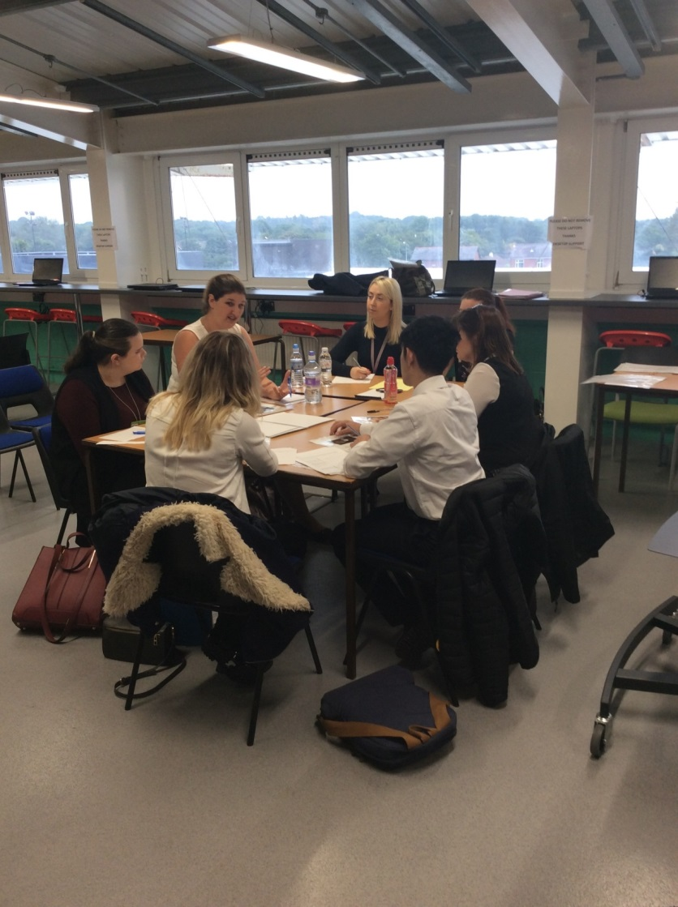
Intensive interview process
Application form demonstrating appointable as band 2
Maths and English test if no certificates available
Pass Maths and English test at 40% to be interviewed
Complete group activities
Complete individual activity
Face to face interview

Slide 13
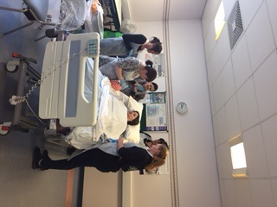
Cohorts
6 cohorts in progress
1st one started in August 2016
66 on programme
27 to start in August
More intakes planned

Slide 14
Apprentice quotes
I am going to try my hardest to complete the level 3 diploma and go onto university and become a staff nurse
I am regularly thanked by patients and have been commended for going the extra mile on several occasions
I have set myself a goal of becoming an advanced nurse practitioner within 10 years of qualifying
I have received unending support from Preston’s College and the Clinical Nurse Tutors at LTHTR
I want to progress onto a ward sisters post
I want to be a specialist palliative care nurse

Slide 15
Use of the funding
Support the delivery of the apprentice programme
Support member of staff to visit apprentices
Developed and overseas programme and supported the first cohort of 15 nurses
We are now an apprentice provider

Slide 16
What we have learnt
Need to only employ band 2 ready staff. True apprentices do not really work
Ensure staff know they can remain as HCA and develop along this pathway
Need to provide interview prep sessions before the attend for BNAP interview

Slide 17
Conclusion
Pathway for development of band 5’s in the Trust
PNAP
AP Scholarship
BNAP
ONP

