Slide 1






Collaborative Learning in Practice

Slide 2

Aim and Objectives
Aim
“ Our aim was to increase placement capacity, enhance student and mentor satisfaction and in turn improve the patient experience.”
Objectives ( at the end of today you will)
Discuss how the Shape of Caring Report ( 2015) and the NMC’s plans to modernise the coaching / mentorship model by 2017 and how this will affect the quality of student education.
Describe how placement capacity can be increased to provide an enhanced and different placement experience for both mentors and students.
Show how you can promote a quality learning environment that supports individual learning requirements whilst enhancing patient care.
Explore the potential to improve recruitment and retention.
How to set up a CLiP ward

Slide 3

Where has this idea come from?
Notes:
Amsterdam to enable the increased nursing student capacity following a recruitment drive
UEA undertaken the pilot and has been running now for 3 years

Slide 4

Notes:
VUmc Amsterdam identified two key differences between what was being delivered in Amsterdam and what we are delivering in the UK. The model is distinct from the traditional mentorship model (Fig.1) in both the way practice learning is organised and in the philosophy that underpins how students learn in practice. Organizationally, under the new CLiP model (Fig.2), rather than working individually with a mentor, students work collaboratively alongside other students under the guidance of a day coach. Typically, on any particular shift, one day coach will be responsible for a group of patients, the care of whom is primarily delivered by students. Coaching underpins the philosophy of learning so that students are supported to take on greater responsibility for their learning and the learning environment embraces a culture of valuing student-focused solutions to care.

Slide 5
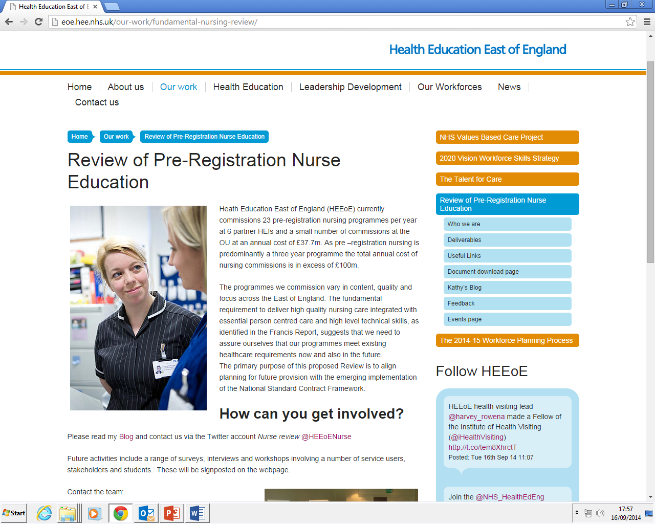
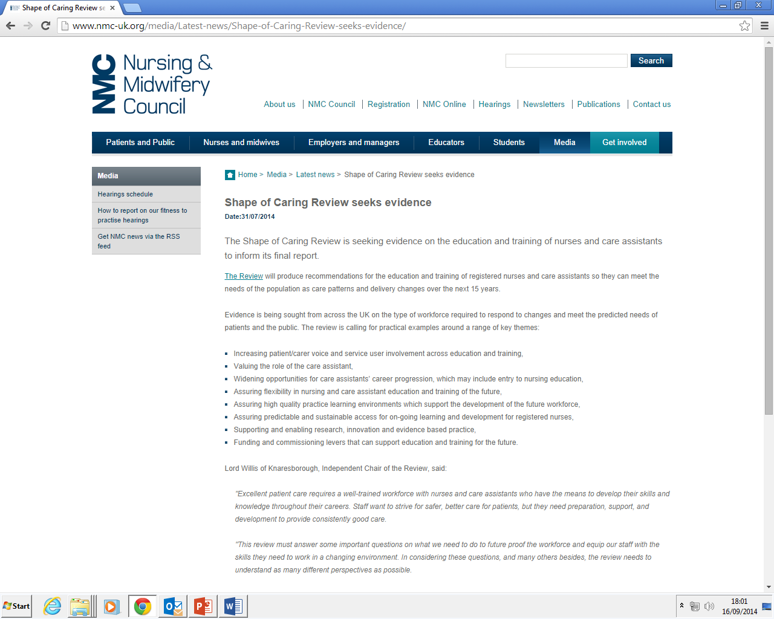
Drivers
Notes:
It is important to be aware of the other drivers that have made and are making a significant impact on the need to change the current model of practice learning.
The first Mid staffs inquiry was key in focussing our energies into developing a robust and systematic process that collated, reviewed and actioned practice evaluations. It also put nursing and nurse education in the spotlight
The subsequent Willis commission highlighted the need for better theory practice integration at organisational and structural levels
Of course the more recent Francis report has significantly placed at centre stage the quality of care and the quality of the learning environment

Slide 6
Existing model of practice learning
No time to learn
Competing priorities
Increase in students
Shrinking pool of trained staff
Relentless influx of students
Increasing workloads
No time to teach
Busy wards
_{unbalanced}
_{unsustainable}
costly
Notes:
For those of you who might not be familiar with mentorship in nursing and midwifery, Our regulatory body, the nursing and midwifery council has set standards for the learning and assessment in practice for students and there is a requirement within these standards that all students are allocated a named mentor in practice who have undertake specific training and there is a requirement that students are able to access a mentor 40% of the time in practice.
Generally and locally this has evolved into a model of one mentor working with one student working at lease 40% of the time, sometimes supported by a link lecturer and a sign-0ff mentor in the final placement.

Slide 7
Existing model of practice learning
Link Lecturer
SOM
Named Mentor
Student
Patients
Notes:
For those of you who might not be familiar with mentorship in nursing and midwifery, Our regualtory body, the nursing and midwifery council has set standards for the learning and assessment in practice for students and there is a requirement within these standards that all students are allocated a named mentor in practice who have undertake specific training and there is a requirement that students are able to access a mentor 40% of the time in practice.
Generally and locally this has evolved into a model of one mentor working with one student working at lease 40% of the time, sometimes supported by a link lecturer and a sign-0ff mentor in the final placement.

Slide 8
Collaborative Learning in Practice (CLiP®)
Link Lecturer
Clinical Educator
SOM
Named Mentor
All YEARS of Students
Coach
Patients
Care delivered to patients through the students
Notes:
This is the new model which reflects the emphasis on coaching techniques. The coaches and the students are supported by the named mentor who is available to them 40% of the time not necessarily together. Still responsible for signing the documentation at the initial/intermediate and final meetings.

Slide 9
How does the CLiP® model facilitate coaching?
Two key differences between the current model and CLiP® that enable this to happen:
The organisational of the practice learning environment
The philosophy of coaching
Time to Teach, Time to learn
Notes:
Within the context described in the previous slides, the aim of the CLiP is to create time to teach and time to learn

Slide 10
What is coaching?
‘A process of support offered to an individual, which is performance focused, goal centred and results in action’ (Ho et al. 2007)
‘Enabling students to find solutions to their own problems’
‘Drawing out solutions through effective questioning and listening skills’
‘Non-hierarchical’
‘Does not depend on any expert/subject specific knowledge’
      (Allison & Harbour, 2009)
Notes:
Defining coaching

Slide 11
What does it mean for the Coach
To supervise students delivering care
Observes, questions, encourages
Patient allocation
Can sign off specific outcomes/competencies
What does it mean for the mentor
May not work with student all time
Overall accountability
May have a sense of loss
Regulate review meetings
Signs off placement
Proposed
1 coach : 3 students
Coaching model
1 student : 1-3patients
Min of 14 students on ward
Current model
1mentor:1student
Expert : Apprentice
Work together as much as possible
Capacity variable
What does it mean for organisation
Preparation is Key
More confident staff
Newly qualified nurses better prepared for practice
Shorter preceptorship
CLiP
What does it mean for student
Take responsibility for own learning
Prepare daily to achieve goals
Learn by doing
Peer learning
More time to care, more time to learn
What does it mean for patients
Not all cared for by students
They have choice
Will get more time to care
Greater patient contact
Excellent care delivery

Slide 12
The Benefits of Coaching
NHS & Department of Health Leaderships Centre (2004) identified:
Improved reflection skills
Promotion of growth and development
Enhanced thinking
Increased self-esteem
Job enrichment and performance
Increased ability to deal with and resolve problems
Confidence building in decision making
Improved self-worth and job satisfaction
Increased motivation
Notes:
Ask: what are the benefits of coaching, why take this approach

Slide 13
Benefits of CLiP®
Builds students confidence at an early stage
Increased resilience as the learners are making own decisions and having to find own answers.
Team working/understanding the MDT role
Time management improvement evident
Increased skill and competency base
Better prepared for practice
Increased support noted leading to higher recruitment and retention in those areas

Slide 14
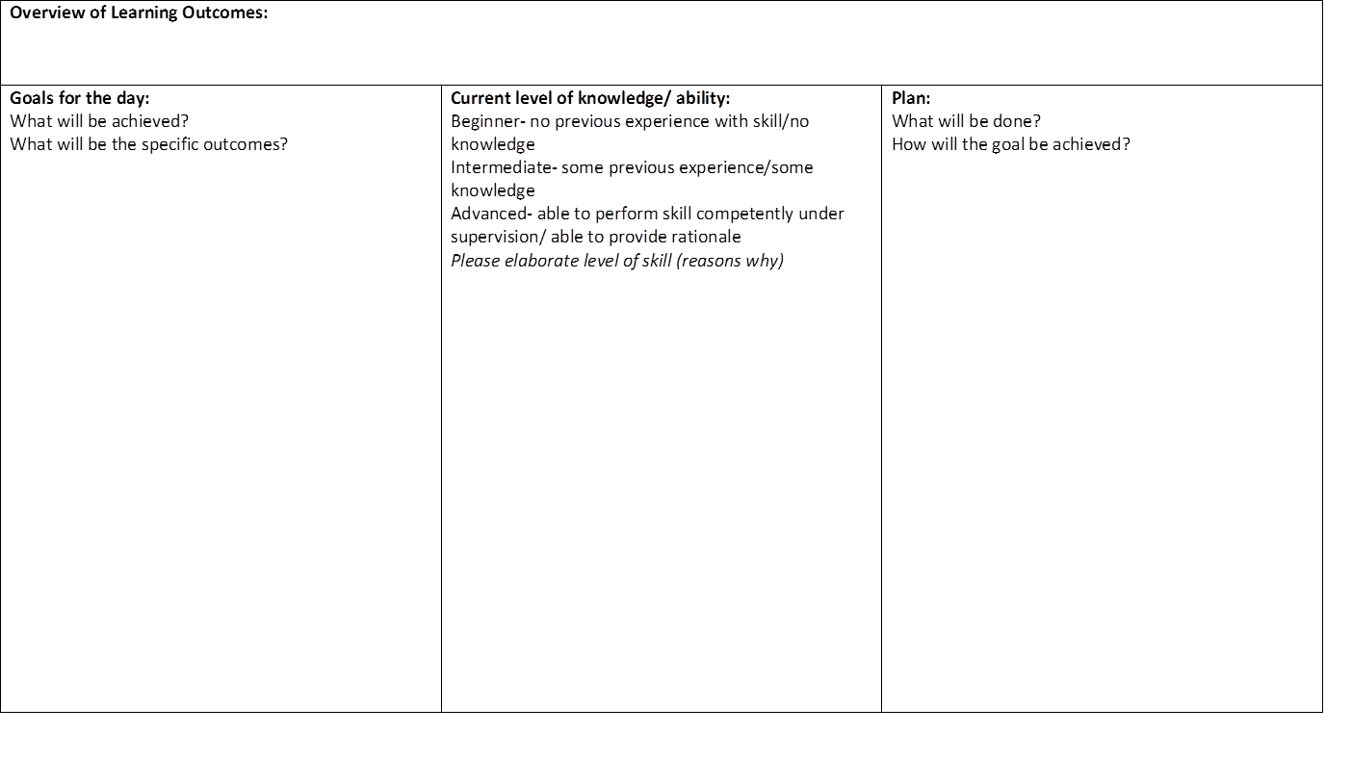
Notes:
Talk through how, when and by whom the learner log is completed
To be completed daily by individual student
Directs own learning needs
Their own goal specific to them
Kept on ward for mentor and other coaches to access to aid assessment.
Kept at end of placement by student for their portfolio

Slide 15
Future of CLiP®
We have now rolled this out on to 6 wards across the Trust.
In October we will have a Neurosurgical floor and Orthopaedic floor, by opening 3 more wards.
Roll out trust wide with all disciplines to include undergraduate medicine.
Raise awareness country wide in line with the NMC standards for education following funding from HEENW. Sharing expertise with the synergy groups in Manchester.
Full evaluation of the process to be published, working in partnership with HEIs involved

Slide 16
How to set up a CLiP® ward
Set up steering group
Request voluntary ward involvement
Audit the area (number of mentors/patients)
Spend time with the staff discussing the implementation of CLiP
Undertake coaching training of all staff involved on the ward
Induct the students to the process prior to placement
Fully support the ward areas in the initial phases.

Slide 17
Quotes from those on the project…
“I felt vulnerable at the start of the training, without the handholding, I thought ‘where’s my mentor’”
I can not believe how the first years develop, I was never as confident at this stage of training
“The confidence and progression, I’m able to do things normally the staff nurses would do”
“Before I never used to think about all these little details, before I was so much more reserved”
“Students have changed, there is a changed atmosphere, a can do attitude, people want to learn and they know what’s going on”
(ward manager)
“I felt more independent, able to work things out”
“I love it now, I feel I can manage the process because I can think for myself, it makes it so much easier”

Slide 18



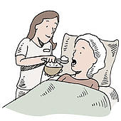




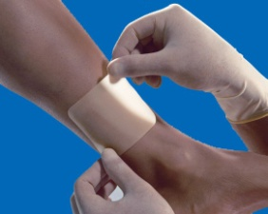





Any Questions?

Slide 19
For more information about CLiP
Please contact
Jonty Kenward (Collaborative Learning Manager) on EXT: 8111 or email jonty.kenward@lthtr.nhs.uk

