Slide 1

Challenges associated with promoting effective interdisciplinary teaching & learning from an HCPC background
By
Martha John-Rose

Slide 2
Focus of my Presentation
Highlight why this is an important area going forward
PEF role from a social work perspective and promoting interdisciplinary T&L
Independent reflection from my professional experience and perspective including patient/ service user perspective
Example of effective outcomes for interdisciplinary T&L using social work and joint nursing & social work collaboration
Issues discussed are general and not specific to my trust
Notes:
I currently am employed as a PEF – but approach this subject as an Independent because the perspective I am offering is my own.

Slide 3
Who am I…
…the young & adult carer, frontline support worker/mental health/learning disability/young people, “BAME”. The Social worker (with a passion for community ‘person potentially driven’ inclusive and creative social work of social work students). Educator (practice learning & HEI), instigator of a Residents Association group…
Notes:
Who is this person speaking to you? - I want to begin with some perspective by setting out who I am and how this applies

Slide 4
Why am I doing this?
Sharing cross perspective experience of challenges interdisciplinary working
Impact for emerging health & social care picture
The patient (service user) experience
“Integration is about placing patients at the centre of the design and delivery of care…”
Integration of Health & Social Care services
“Integration aims to overcome organisational, professional, legal and regulatory boundaries within the health and social care sectors…”

Slide 5

The SW PEF & The ‘Multi-Professional
Experience in Healthcare
Physio | Reg Nurse | Midwife | Social Worker | Non traditional Integration partners
HCA |  | TNA’s | Frontline Step Up Standard Degree Course | Health social Care Foundation degrees
Integration & Multi professional
boundary
Apprenticeships

Slide 6


Professional Grounding creates challenges for interdisciplinary T&L?
Language Barrier
Fundamental differences - perspectives
priorities and
Solutions
Service user
“The patient”
Health & illness
Social care/ issues
Evidence
& credibility

Slide 7
Working to a new narrative affects all
Diagnostic
Patient
Acute Care
Dialogic
Individual
Community

Slide 8
Effective Interdisciplinary T&L requires effective communication
Social work ‘speak’
Social Justice
Holistic Reflective
Roots in social model
Healthcare ‘speak’
Improving/saving lives
Pragmatic
Roots in medical model
Language differences
Impact

Slide 9




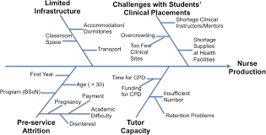
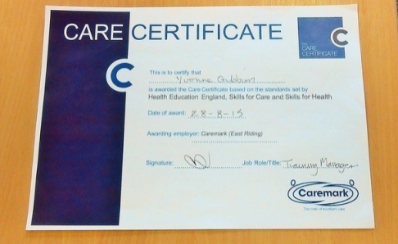

Navigating the Challenges - Students

Slide 10

“Mind the GAP”

Slide 11



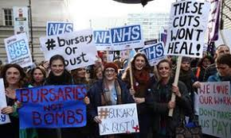
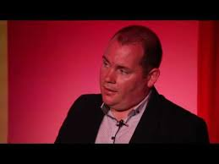
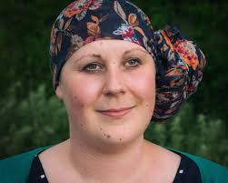



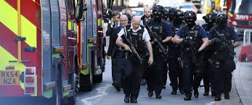

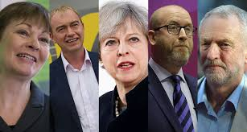
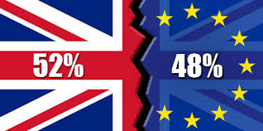
mynameis Campaign… ‘In this day and age?’
Challenges to effective interdisciplinary

Slide 12

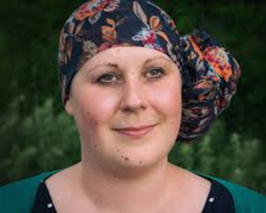
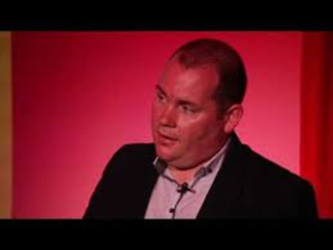
‘mynameis’ Campaign
Gives evidence to the stories
I FEEL MUGGED! “The experience felt like having people come storming in to my life without warning or explanation, who had come to take over control of my life. I did not know the extent of their powers, I was unclear about their role. I did not feel it was ok to ask questions. I felt it was expected and acceptable that I would be uninformed. It felt as though it was not expected for me to express choices. I felt like an object that was used for their convenience and then dropped when they were tired of me leaving me with the consequences of their actions. My impression was it would have been more convenient for them had I been isolated, uninformed and passive
I wasn’t always disabled. I was a busy mum, an OT student, working, driving, etc until quite recently. I am still adjusting to having reduced mobility, independence, and control over my life
There is an attitude of expectation that because I am disabled there should be a designated person of authority to speak on my behalf on all matter. It is not expected that I should be the person who is consulted on matters that concern me. (2013)

Slide 13
An Example of effective interdisciplinary T&L -
Nursing Students
Nursing & Social work
An example of integration
Social Work Social
PAD
Hours
‘competency’ style assessment
Signing off of competences
Initial, mid and final placement meeting
Mandatory amount of hours over specified period
Portfolio
Days
Holistic assessment
Summative assessment of portfolio of written exercises
Formal Supervision with practice teacher 1.5 hours per week
2 x Fixed assessment periods (70/ 100 Days)

Slide 14

Effective Interdisciplinary T&L requires effective communication
Social work ‘speak’
Social Justice
Holistic Reflective
Roots in social model
Healthcare ‘speak’
Improving/saving lives
Pragmatic
Roots in medical model
Nursing lecturer
Social Work
Lecturer
Language differences
Effective
Impact

Slide 15
An Example of effective interdisciplinary T&L - a model for the future?
Benefits –
Integrated key skills and knowledge
A workforce better equipped for emerging model of health and social care (e.g. integrated roles)?
Disadvantage –
Systems and processes for support
No distinct recognition by regulators (NMC or HCPC)

Slide 16
Thank You
Thoughts & Questions ?

