Slide 1


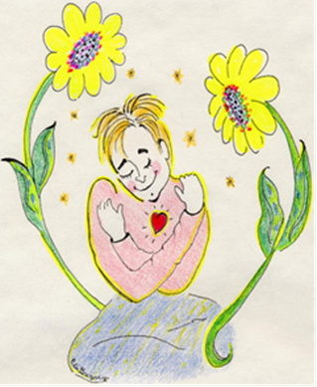
Welcome
https://youtu.be/2TvWZEVf6go

Slide 2

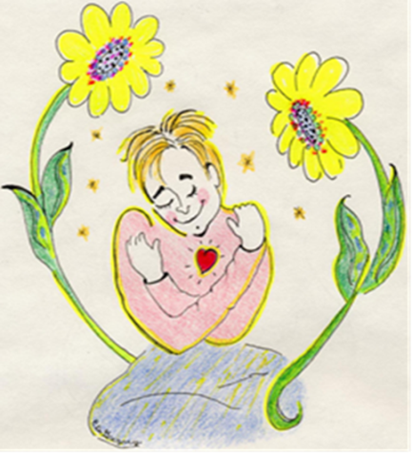

The Mental Health and Emotional Well Being Toolkit: A Resource for Mentors
Thriving not surviving: Prioritising emotional and mental wellbeing of our future nurses/midwives on placement
#icareforme

Slide 3

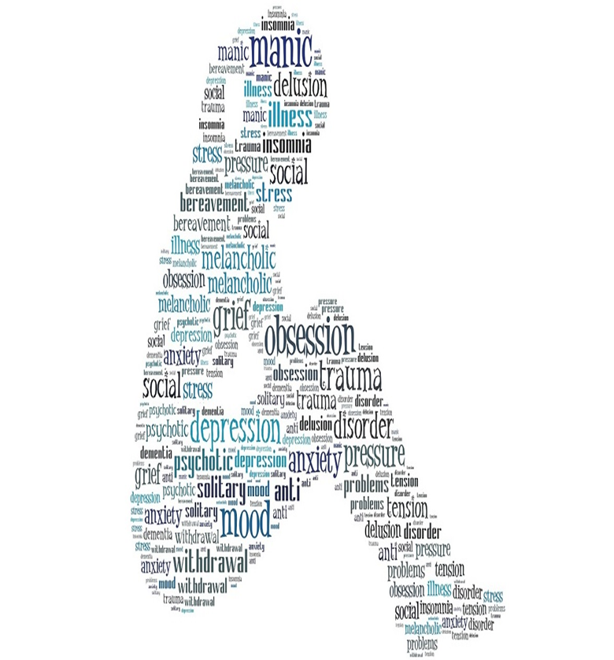
Mental Health?

Slide 4

The Stats
29% of students may experience mental health difficulties at some point during their studies
National Union of Students (2015) have this figure much as high as a possible 78%
For Nursing Students …?

Slide 5
The Project
To develop a practical and user friendly toolkit that helps practice educators & mentors when working with students who are experiencing emotional distress and/or mental ill-health and who may be in need of support
Enable practice educators and mentors to feel more confident in supporting and signposting students appropriately through a challenging time for both student and mentor
The Aim

Slide 6

Why Now?

Slide 7



Slide 8

The Gap…
Attrition
Expectations
Placement itself
Resilience
Emotional Labour

Slide 9



In Groups
What is it about the healthcare environment that takes from us emotionally?
Use examples from practice where possible and please be prepared to share …

Slide 10

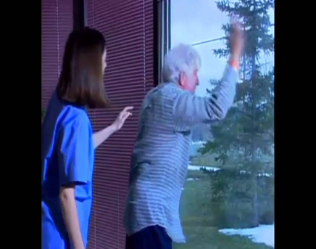
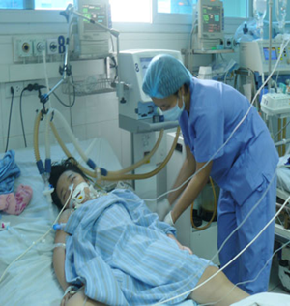


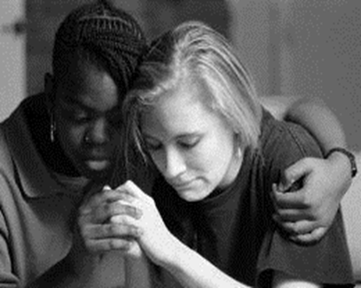
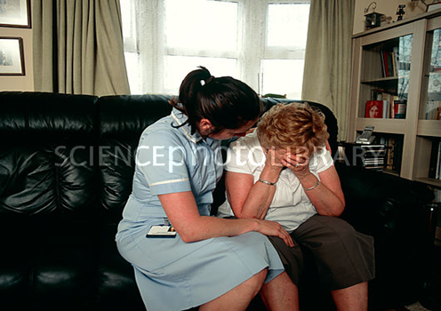

Slide 11

Working in Healthcare
Noise Annoys?
https://youtu.be/ewYDs5FRr8o
2. https://youtu.be/SjKt5WF5eCw

Slide 12

The Environment
Inflexible
Fast-paced
Accountable
Biomedical and clinical models dominate health care practice
Emotional, complex, messy and opaque
Emotional labour in healthcare frequently found in places that are hidden or unrecognised.

Slide 13


Slide 14
Top Ten Tips for Good Mental Health
Having the conversation
Signposting
Agencies
Support structures
Mindfulness

Slide 15


Groups…
So …how do you keep your mental health bank account topped up?

Slide 16
Where are we now?

Slide 17

This work prioritises the core values of the Trust including empathy, respect and compassion
We want our students to feel a sense of belonging, feeling that they are listened to and matter to us as an organisation

Slide 18
In Conclusion …
“So …students who struggle with mental health are not any less than any other student.
They are not solely intent on trying to get by and earn a degree. These students have the potential to change the world – the same as anyone other student does. In order to ensure that these students have their best shot at chasing after whatever life has in store for them.
Professionals supporting students need to care about mental health in a way that enables and equips them to confront difficult situations, and shine light and hope into dark places”.
Becci O’Donnell, The Student Affairs Collective Website, 2017

Slide 19
Sharing Best Practice
You can access the Toolkit here as an ewin with HEE:
http://www.ewin.nhs.uk/tools_and_resources/mentor-toolkit-support-mental-health-and-wellbeing
(no log ins required)

Slide 20

Thank you for Listening!
Any Questions?

Slide 21
Reference list:
Christine Deasy, Barry Coughlan, Julie Pironom, Didier Jourdan, Patricia Mannix-McNamara, (2015) Psychological distress and help seeking amongst higher education students: findings from a mixed method study of undergraduate nursing/midwifery and teacher education students in Ireland, Irish Educational Studies
Royal College of Nursing. (2007) Guidance for mentors of nursing students and midwives. [Online] [Accessed on 5th April 2017] https://www2.rcn.org.uk/__data/assets/pdf_file/0008/78677/002797.pdf
Royal College of Psychiatrist. (2011) Mental health of students in higher education: College report CR166. Royal College of Psychiatrists. [Online] [Accessed on 5th April 2017] http://www.rcpsych.ac.uk/files/pdfversion/CR166.pdf

