Slide 1
www.onlinepare.net

Slide 2
Overview Of OnlinePARE Project
Project funded by Health Education North (NHS England)
Started in 2013 when the need for a standardised evaluation tool was identified
Funding was also allocated to develop an online version of the Cheshire/Merseyside Nursing PAR
The projects merged – hence, PAR and E
We work with 10 Universities across the North West
We are based at the University Of Chester

Slide 3
The Team
Mike Brownsell - Chair of steering group and project lead
Pat Roberts – Support, administration and training
Tom Stack – Lead Web Developer
Andy Stead – Web Developer
Coming soon (we hope):
A third web developer
A dedicated administrator

Slide 4
Evaluation
A standardised multi-profession question set
Every student on placement in the North West answers the same questions
This allows reports and comparisons across the region
PEFs and team/ward managers can view evaluation data within the trust
University academics can view evaluation data from their students only. University staff will never have access to student data from another university

Slide 5
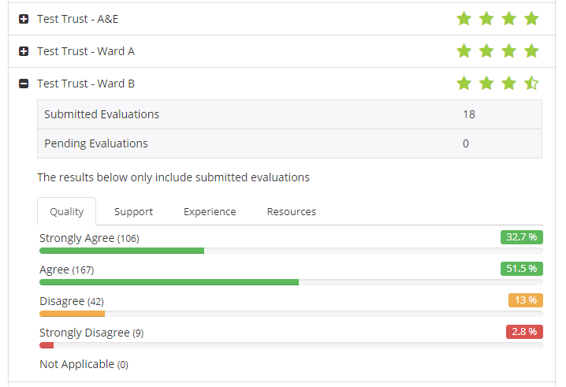
Evaluation - Screenshot

Slide 6
Practice Assessment Record (PAR)
Replaces the paper version
Designed to mimic the paper version as closely as possible
Advantage of online version:
Students cannot lose their documentation
Mentors, Team/Ward managers, PEFs and Academics can view documentation at any point while the student is on placement
Prevents fraud – students cannot forge their mentor’s signature
(unless the mentor the gives their password to the student! Don’t do this!)
Mentors have an audit trail of all signatures and can create a report for their triennial review
The system sends reminders to student and mentor when certain sections are incomplete

Slide 7
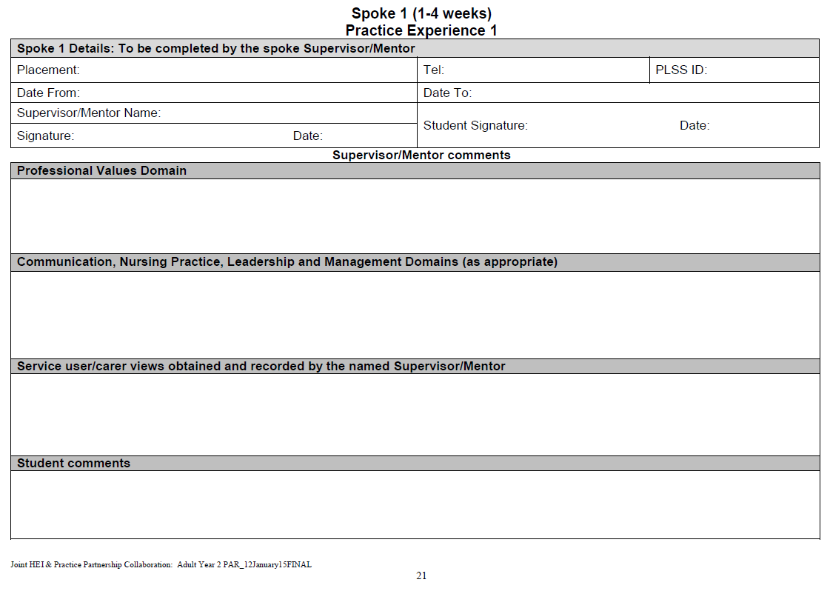

Slide 8
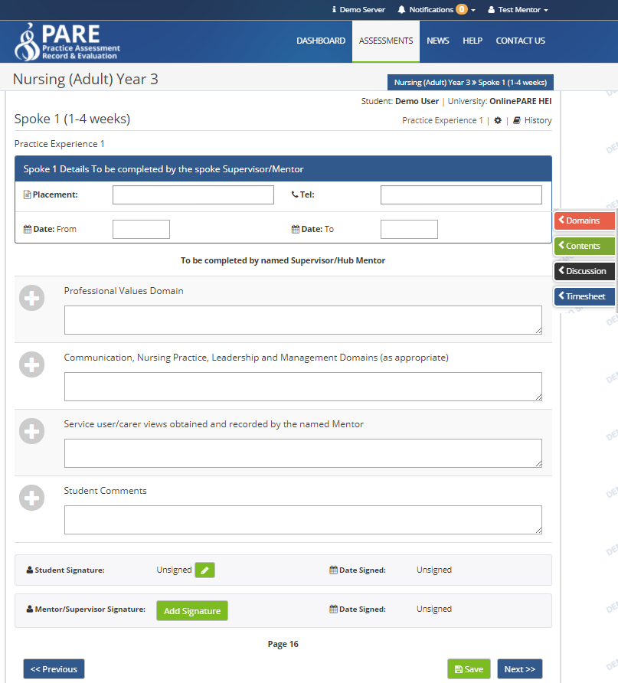

Slide 9
Timesheet
Replaces paper version
Custom day types per university
Advantage of online version:
Students cannot lose their timesheet
Mentors, Team/Ward managers, PEFs and Academics can view the timesheet at any point while the student is on placement
Reminders sent to student and mentor when they fail to enter their hours for more than a week
Mentor can sign with a name and phone number if the university allow it
This allows unregistered mentor to sign the student off (may not be available)
The overall mentor signature must be the named mentor

Slide 10
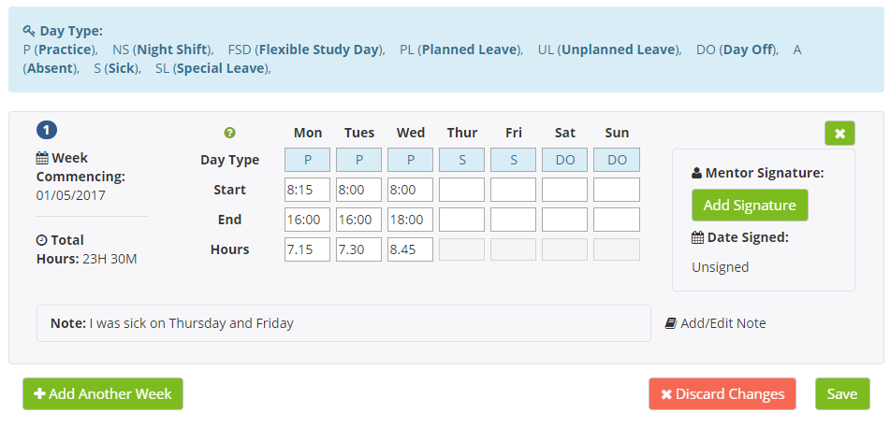

Slide 11
Training and Support
We have an extensive list of frequently asked questions (FAQs) on our website
There are many training videos available on the website or our YouTube channel
To access the training resources, click the Help tab on the homepage, followed by ‘Videos & Training Resources’
To find our YouTube channel, search for ‘onlinepare’
Other avenues for support are:
The PEF at your Trust
If you have questions relating specifically to a university’s document, please contact your student’s tutor or module leader
For everything else, the ever helpful Pat can be contacted at info@onlinepare.net

Slide 12
Training and Support

Slide 13
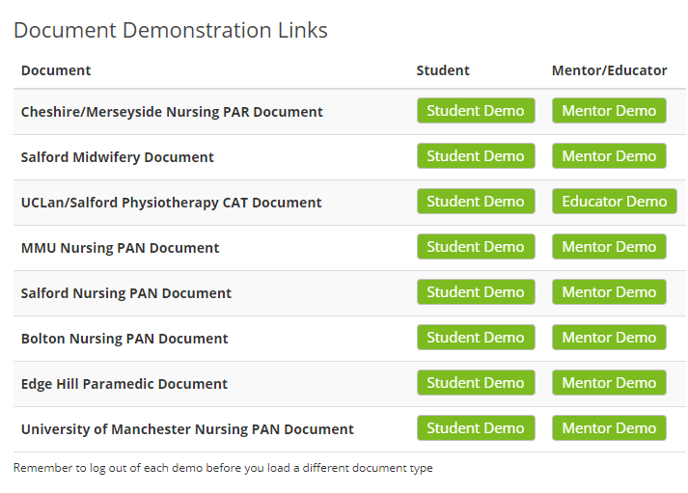
Demo The OnlinePARE
On our homepage, we have various demo links to documents from each of the universities we work with:

Slide 14
Question Time
If you don’t get a chance to ask a question now, please email us:
info@onlinepare.net

